Slide 1

REACT

Slide 2

Web Development
(Front-End)
HTML (Hypertext Markup Language)
CSS (Cascading Style Sheet)
JavaScript (Programming Language)

Slide 3
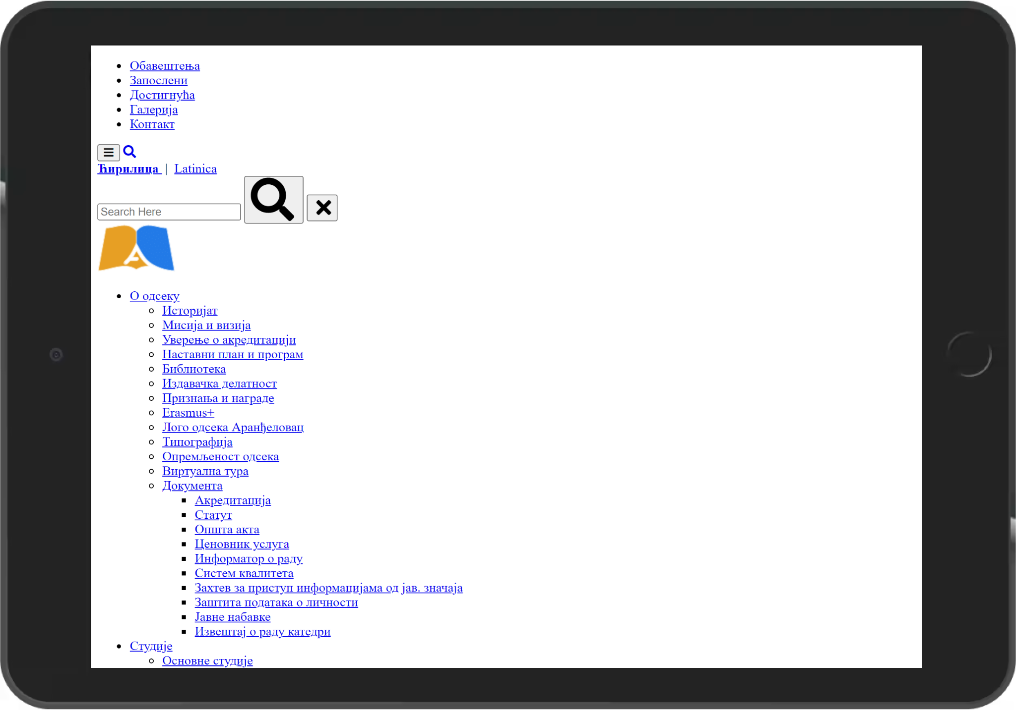
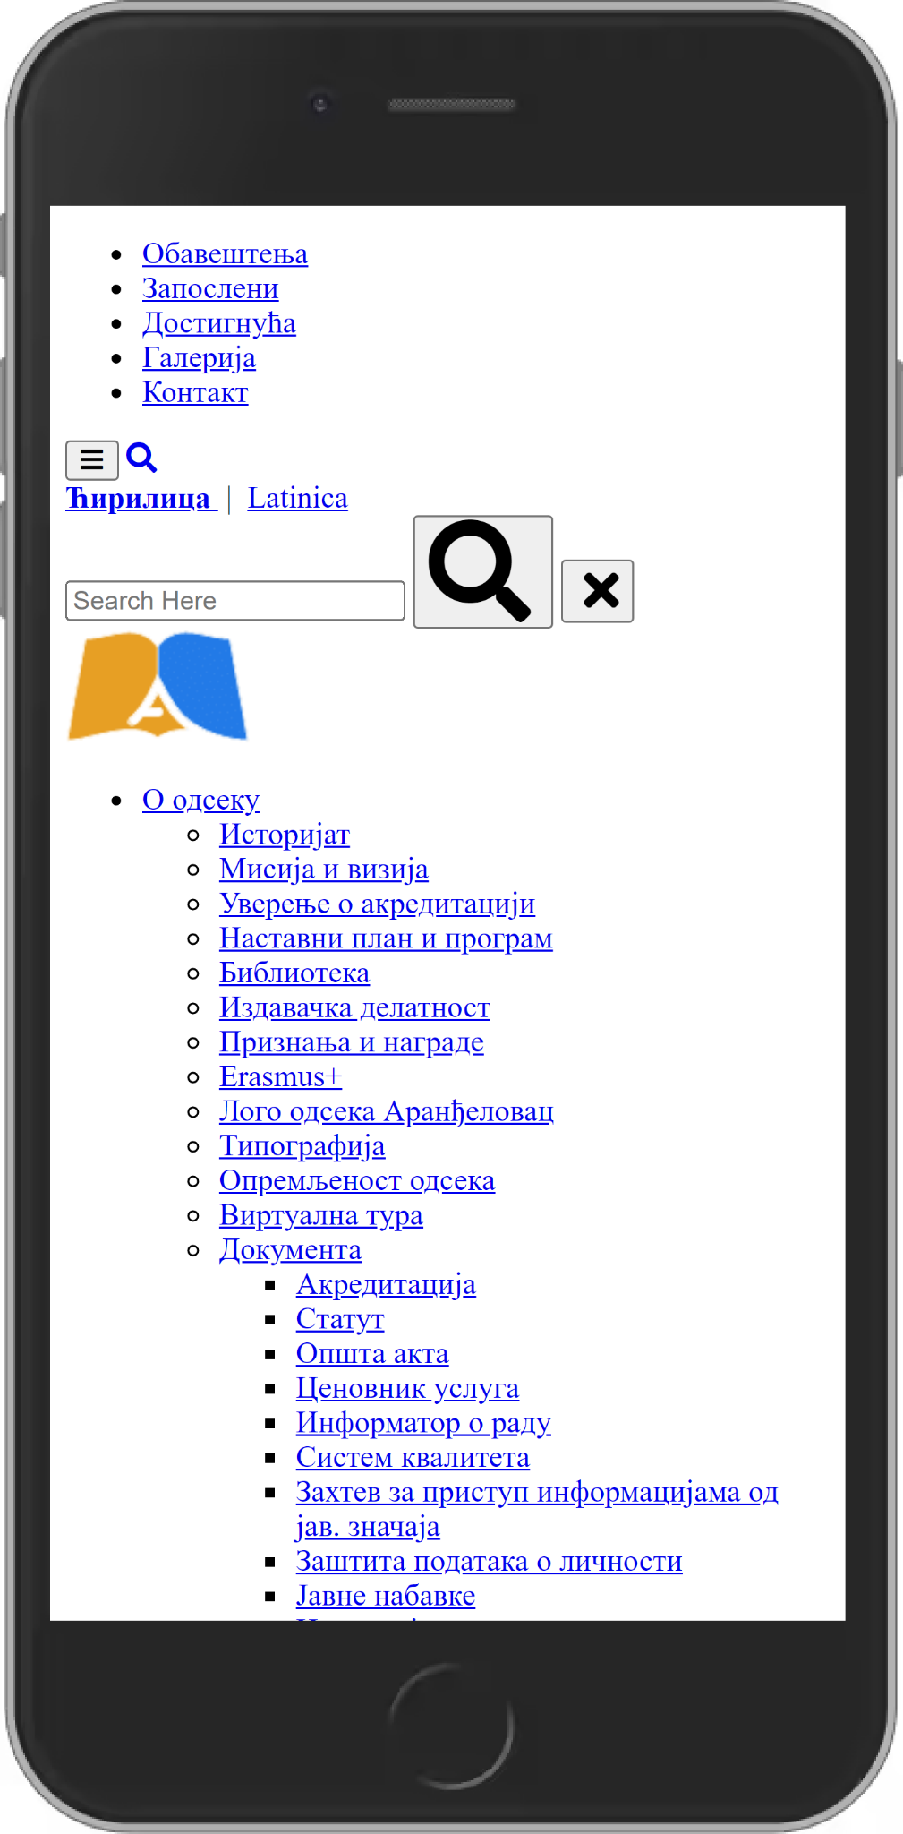
HTML

Slide 4
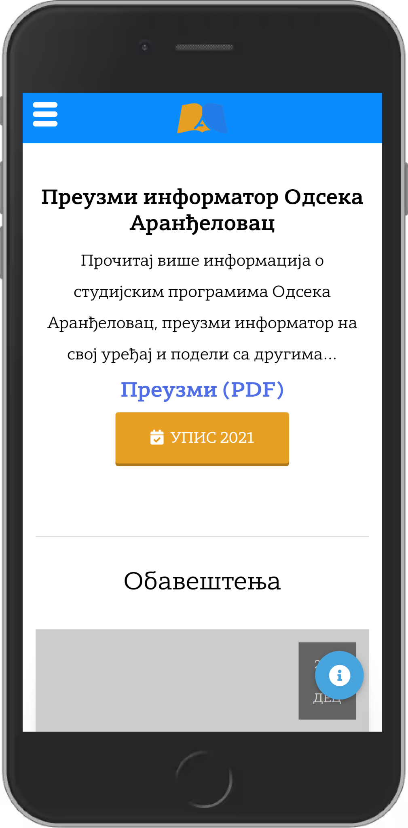



CSS

Slide 5

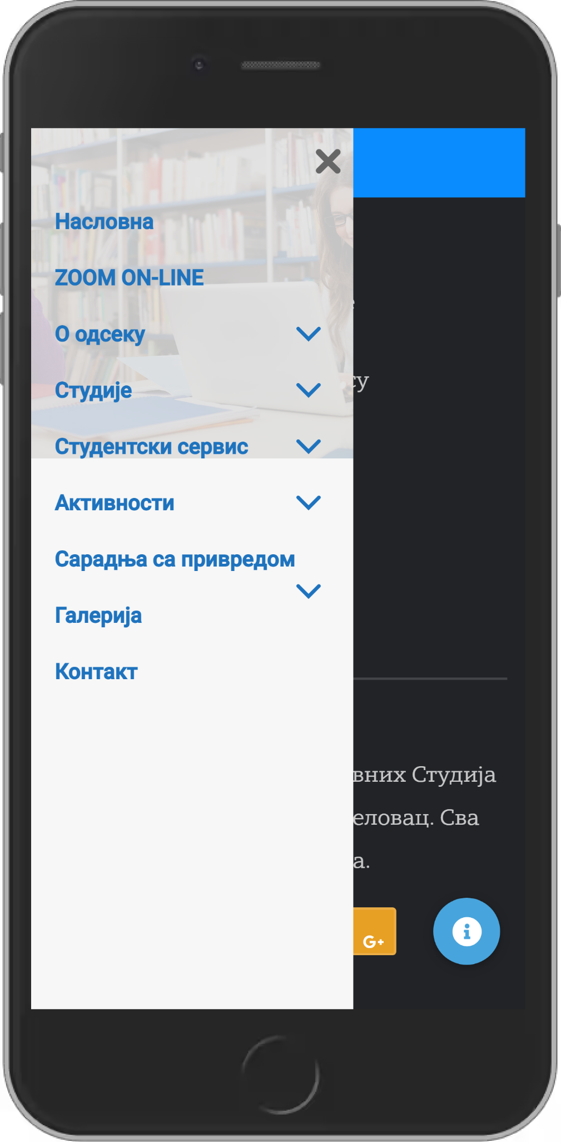
JavaScript

Slide 6
React
What is React?
Who made React?
A JavaScript library(Framework) for building user interfaces.
Facebook (Jordan Walke - Software Engineer with 15+ years of Experience).
Why React?
Easy to learn, Fast Render,
Reusable Components etc.

Slide 7
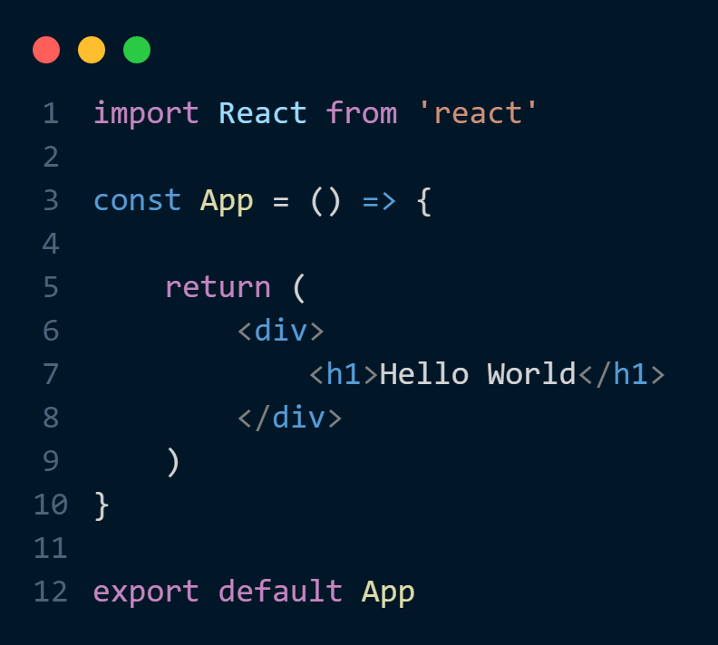
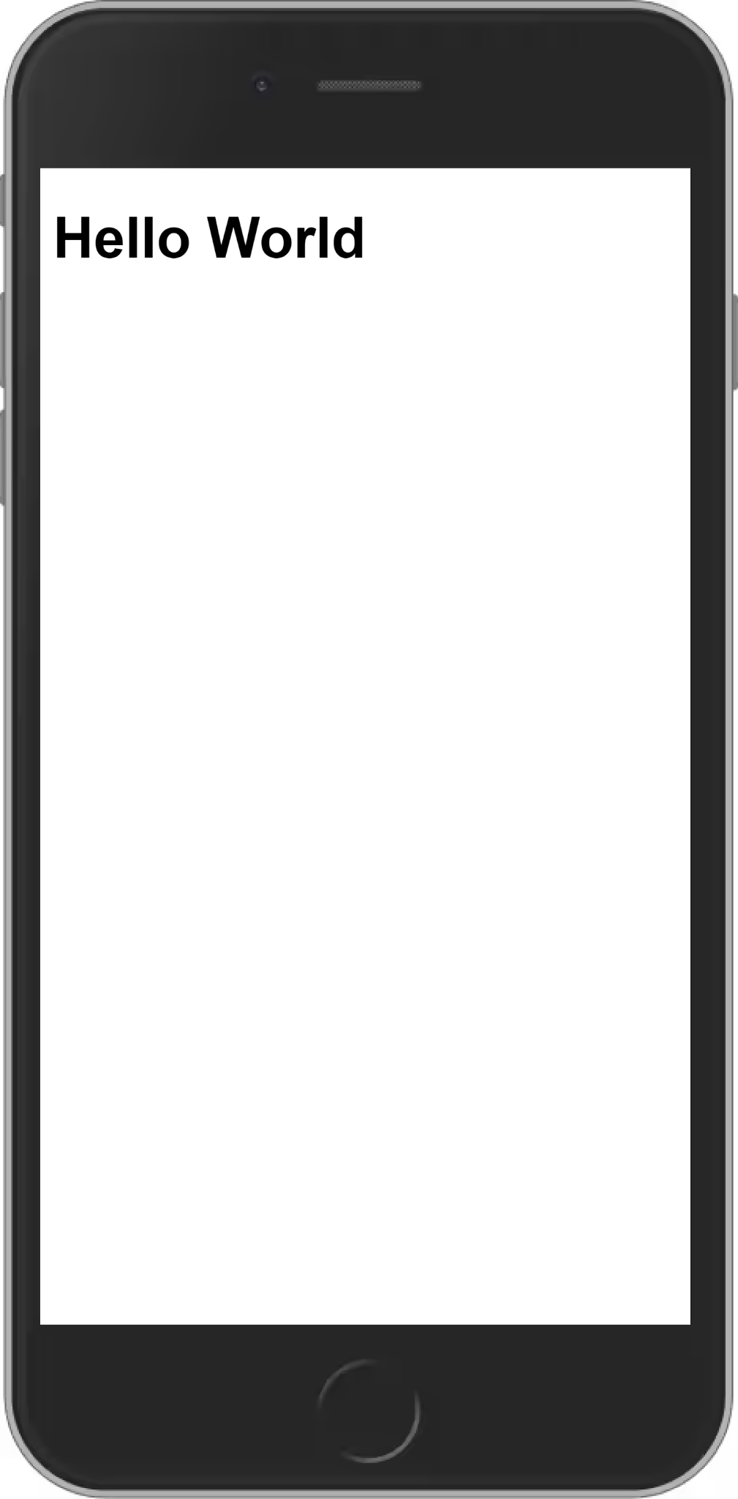



React JSX

Slide 8
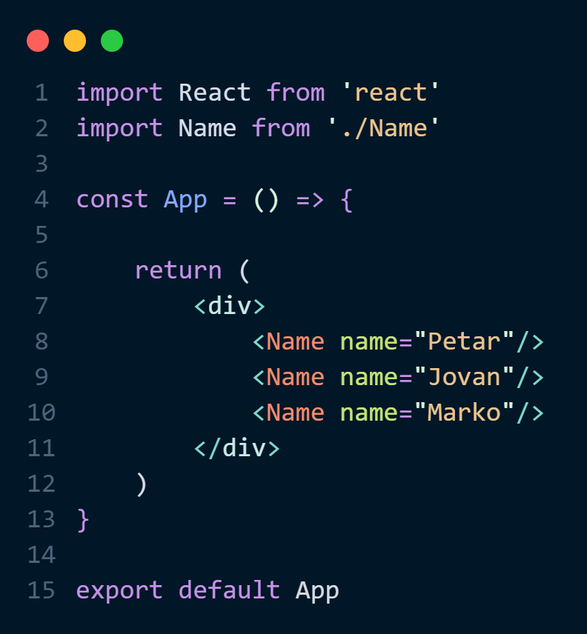
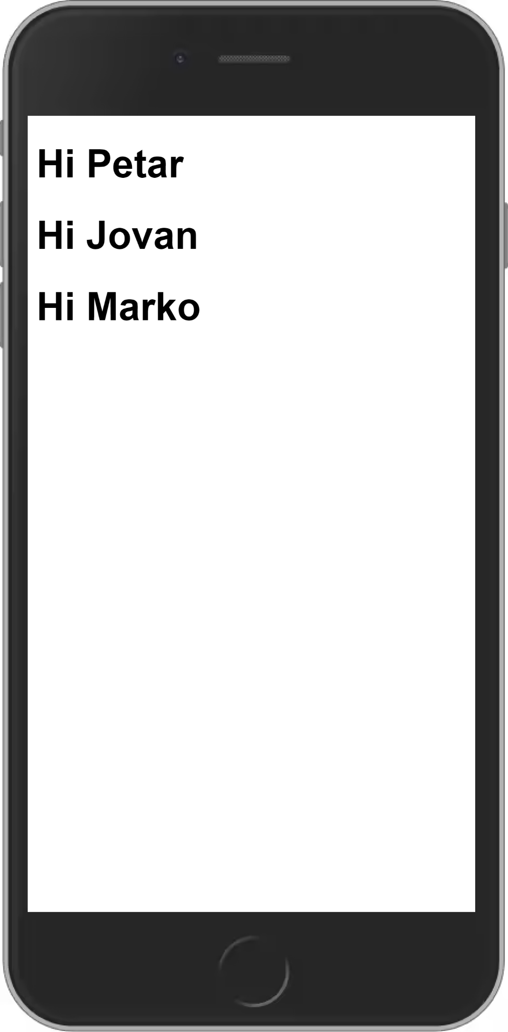
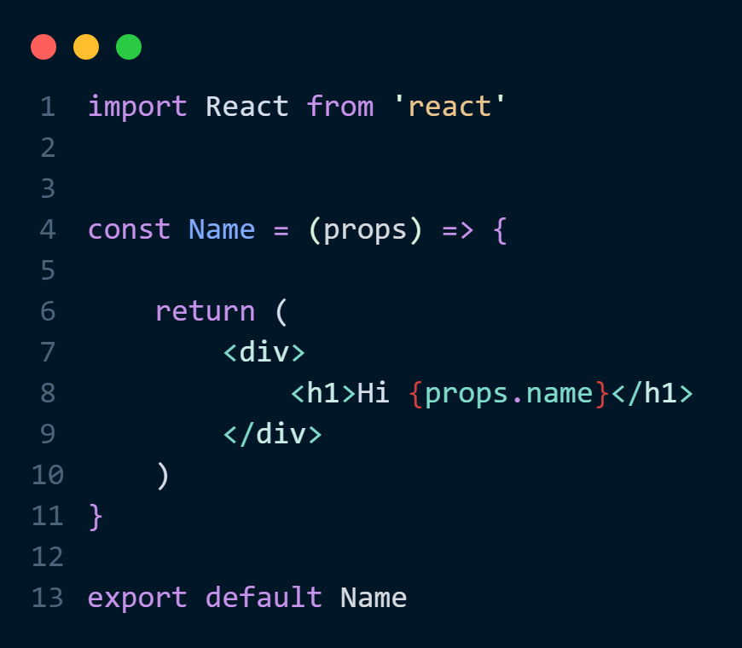
React Props

Slide 9
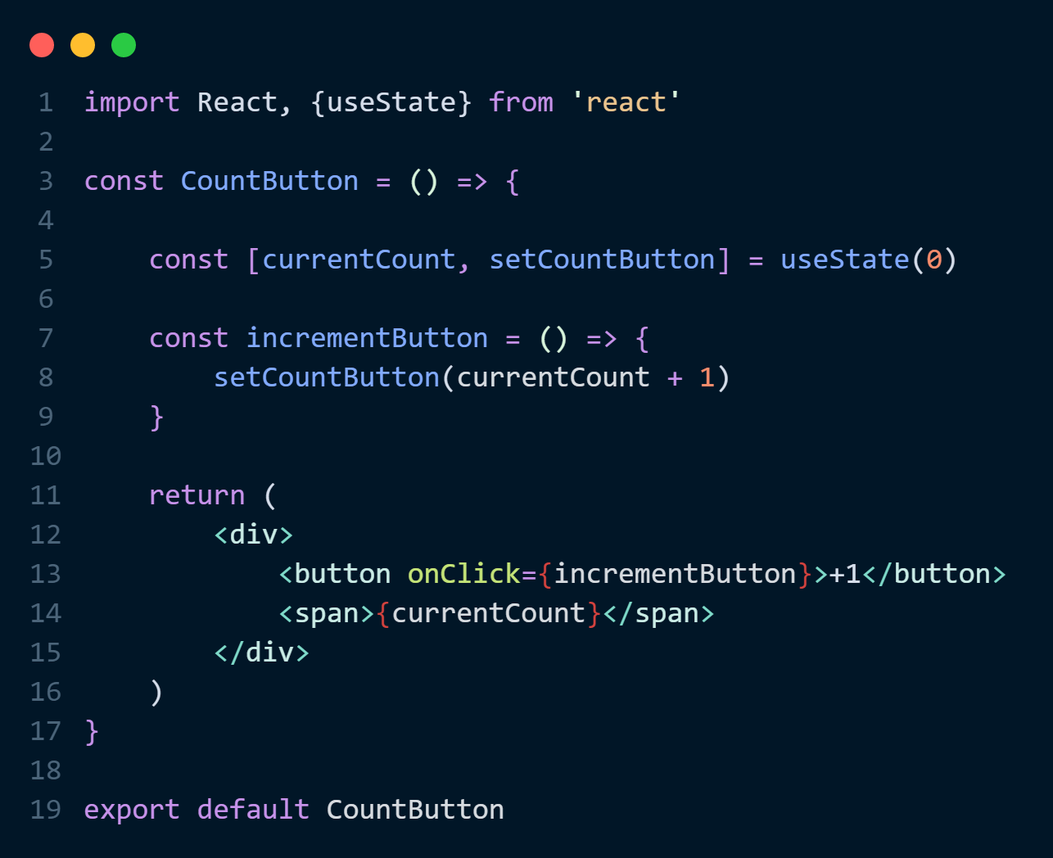
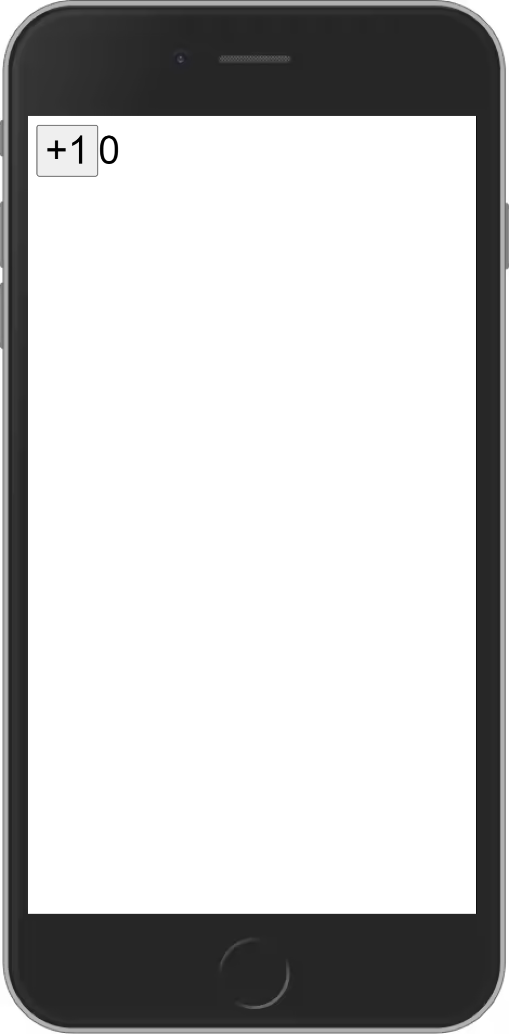
React Hooks

Slide 10
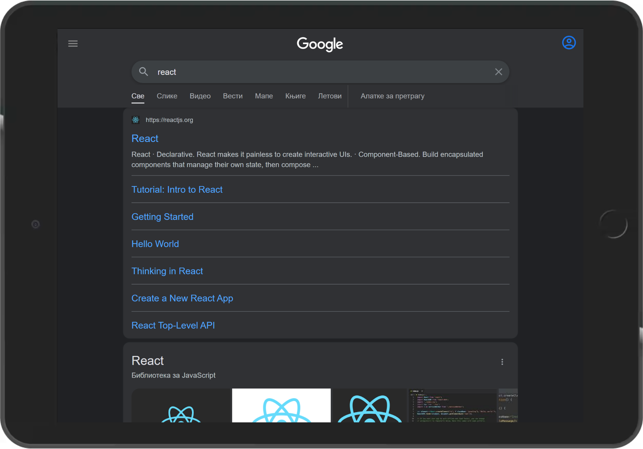
Components

Slide 11
React Element vs DOM Element
Virtual DOM vs Real DOM
Virtual DOM
Real DOM

Slide 12
That’s It.
R. Veljko

